Slide 1
UFCFVK-15-2 Internet of Things

Slide 2
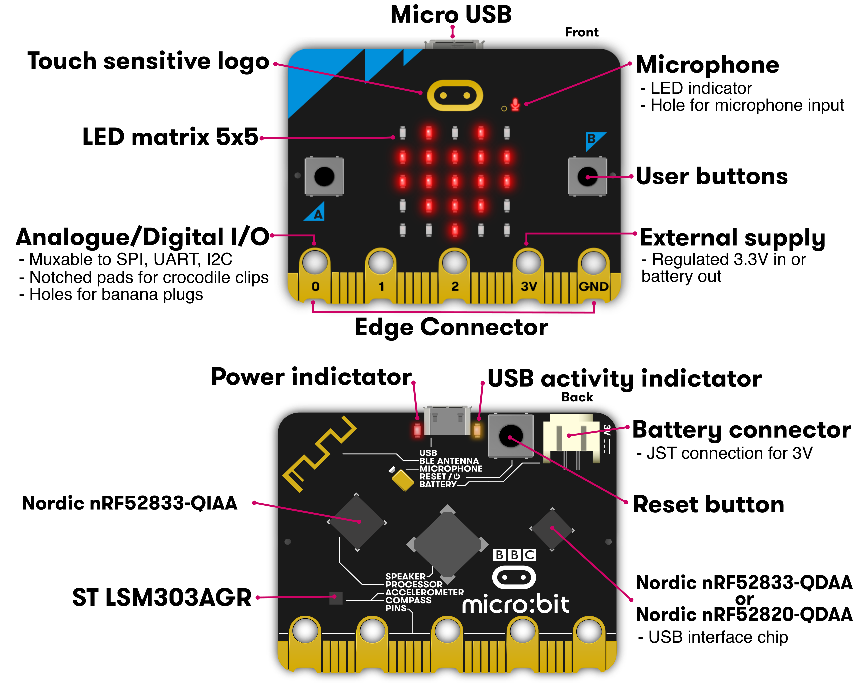

Slide 3
BBC micro:bit Software Stack
main focus
more advanced

Slide 4
The micro:bit runtime provides a Device Abstraction Layer, that is built using Arm-Mbed (Arm Mbed OS is a free, open-source IoT operating system that includes all the necessary features to develop IoT products)
Arm Mbed TLS provides a comprehensive SSL/TLS solution and makes it easy for developers to include cryptographic and SSL/TLS capabilities in their software and embedded products
(Mbed OS is the fastest way to build IoT products with Arm processors)

Slide 5
Device Abstraction Layer
Sitting below the runtime the DAL was created at Lancaster University in the UK and is made up of 4 main components:
core
High-level components such as Device, Font, Heap Allocator, Listener and Fiber, often implemented on-top of 1 or more driver classes
types
Helper types such as ManagedString, Image, Event and PacketBuffer
drivers
For control of a specific hardware component, such as Accelerometer, Button, Compass, Display, Flash, IO, Serial and Pin
bluetooth
All the code for the Bluetooth Low Energy (BLE) stack that is shipped with the micro:bit
asm
Just 4 functions are implemented in assembly, they are swap_context, save_context, save_register_context and restore_register_context. As the names suggest, they handle the ‘context switching’ necessary to make the MicroBit Fiber scheduler work

Slide 6
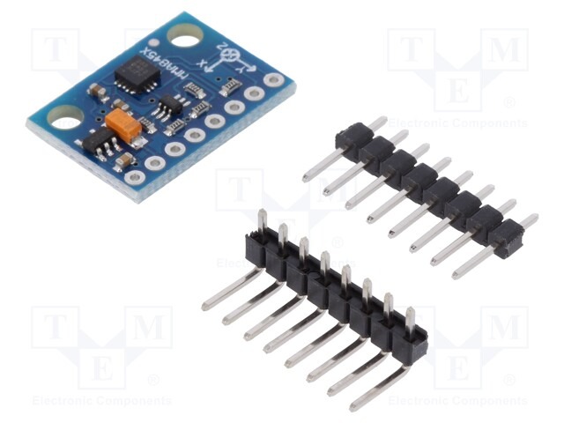
Accelerometer to detect the system is falling, seismic activity or to flip the phone to snooze
On stable position the device can only measure free fall, force of gravity.
Accelerometer to detect the system is falling, seismic activity or to flip the phone to snooze
On stable position the device can only measure free fall, force of gravity.

Slide 7
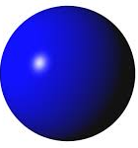
- Y
- Z
- X
Z
X
Y

Slide 8
X
Z
X = 0g
Y = 1g
Z = 0g
Y

Slide 9
Fibers are lightweight threads used by the runtime to perform operations asynchronously. The function call release_fiber()
Managedstring represents a text string in the micro:bit runtime. A string is simply a sequence of characters such as "joe" or "micro:bit".
In the C language, the end of the string is marked by a special character (a NULL character, commonly with the value zero).
Simple strings are often represented as literal character arrays:
uBit.display.scroll("HELLO");

Slide 10
Which is almost exactly the same as:
char message[6] = {'H', 'E', 'L', 'L', 'O', 0}; uBit.display.scroll(message);

Slide 11
DAL and Fibers
Provides nice helper classes for working with the underlying devices
Additionally the DAL provides the Fiber abstraction
supports asynchronous functions
useful as it enables, for example, code to asynchronously display text on the LED display without blocking and hence stop other code from running, whilst scrolling across the screen

Slide 12
mbed classic
The software at the bottom of the stack make use of ARM’s mbed OS:
.. an open-source embedded operating system designed for the “things” in the Internet of Things (IoT). mbed OS includes the features you need to develop a connected product using an ARM Cortex-M microcontroller
mbed OS provides a platform that includes:
Security foundations
Cloud management services
Drivers for sensors, I/O devices and connectivity

Slide 13
micro:bit hardware
Nordic nRF51822
16 MHz 32-bit ARM Cortex-M0 microcontroller, 256 KB flash memory, 16 KB static ram, 2.4 GHz Bluetooth low energy wireless networking.
NXP/Freescale KL26Z
48 MHz ARM Cortex-M0+ core microcontroller, that includes a full-speed USB 2.0 On-The-Go (OTG) controller, used as a communication interface between USB and main Nordic microcontroller. This device also performs the voltage regulation from the USB supply (4.5-5.25V) down to the nominal 3.3 volts used by the rest of the PCB. When running on batteries this regulator is not used
NXP/Freescale MMA8652
3-axis accelerometer sensor via I²C-bus
NXP/Freescale MAG3110
3-axis magnetometer sensor via I²C-bus (to act as a compass and metal detector)
MicroUSB connector, battery connector, 23-pin edge connector
Display consisting of 25 LEDs in a 5×5 array
Three tactile pushbuttons (two for user, one for reset)

Slide 14
Fibers
micro:bit solution to concurrency and asynchronous execution
a fiber is a lightweight “thread” of execution
Likes threads they share a single address space
Unlike threads they co-operative multitasking while threads use pre-emptive multitasking
Sometimes called co-routines
Preemptive multitasking is a type of multitasking that allows computer programs to share operating systems (OS) and underlying hardware resources.

Slide 15
pre-emptive multitasking
Threads can be interrupted externally
Thread 1
while(1)
{
printf(“hello 1”);
}
Thread 2
while(1)
{
printf(“hello 2”);
}
hello 1
hello 2
hello 1
hello 2
.
.
.
.
possible schedule (assuming T1 starts first)

Slide 16
co-operative multitasking
Fibers cannot be interrupted externally
Fiber 1
while(1)
{
printf(“hello 1”);
}
Fiber 2
while(1)
{
printf(“hello 2”);
}
hello 1
hello 1
hello 1
hello 1
.
.
.
.
possible schedule (assuming T1 starts first)

Slide 17
co-operative multitasking
Fibers cannot be interrupted externally, so they must give up (yield) control
Fiber 1
while(1)
{
printf(“hello 1”);
yield();
}
Fiber 2
while(1)
{
printf(“hello 2”);
yield();
}
hello 1
hello 2
hello 1
hello 2
.
.
.
.
possible schedule (assuming T1 starts first)
Yield() is an action that occurs in a program during multithreading, of forcing a processor to relinquish control of the current running thread and sending it to the end of the running queue, of the same scheduling priority.

Slide 18
Fibers summary for micro:bit
Fibers are lightweight “threads”, often called tasks in RTOS
They are non-preemptive, providing a simple threading mechanism for two main purposes:
To provide a clean abstraction for application languages to use when building async behavior (callbacks).
To provide ISR decoupling for EventModel events generated in an ISR context
Interrupt Service Routines (ISR) are the portions of the program code that handle the interrupt requests. When an Interrupt is triggered (either a h/w or s/w interrupt), the processor breaks away from the current task, moves the instruction pointer to the ISR, and then continues operation.

Slide 19
What happens with this program?
#include "MicroBit.h"
MicroBit uBit;
int main()
{
uBit.init();
uBit.display.printChar('X');
}
// Initialise the micro:bit runtime.

Slide 20
What about this one?
#include "MicroBit.h"
MicroBit uBit;
int main() {
uBit.init();
uBit.display.printChar('X');
while(1)
{
}
uBit.display.printChar('Y');
}
// Initialise the micro:bit runtime.

Slide 21
Buttons
A and B

Slide 22
Button presses cause an event, which a function (called a callback) can be associated with and is called when the button is pressed
To handle a button press, then we:
Define a function (i.e. the callback) to be called when a given button is pressed
Register the function to be called when a particular button is pressed

Slide 23
Define callback
void onButtonA(MicroBitEvent e)
{
uBit.display.printChar('A');
}

Slide 24
Register callback
uBit.messageBus.listen( );
MICROBIT_ID_BUTTON_A, MICROBIT_BUTTON_EVT_CLICK, onButtonA

Slide 25
Example
#include "MicroBit.h”
MicroBit uBit;
void onButtonA(MicroBitEvent e)
{
uBit.display.printChar('A');
}
int main()
{
uBit.init();
uBit.messageBus.listen( , );
uBit.display.printChar('X');
while(1)
{
}
}
MICROBIT_ID_BUTTON_A, MICROBIT_BUTTON_EVT_CLICK
onButtonA

Slide 26
Example
#include "MicroBit.h”
MicroBit uBit;
void onButtonA(MicroBitEvent e)
{
uBit.display.printChar('A');
}
int main()
{
uBit.init();
uBit.messageBus.listen(MICROBIT_ID_BUTTON_A, MICROBIT_BUTTON_EVT_CLICK, onButtonA);
uBit.display.printChar('X');
while(1)
{
}
}
Problem, we don’t yield control to the scheduler to run onButtonA

Slide 27
Fiber 1
Interupt Service Routine
Transfer control to main
initialize runtime
register callback
display
X
enter loop
External event:
button press
Transfer control to
ISR
register button press
Transfer control back to
Fiber 1
time
jump to start of loop

Slide 28
Problem:
At no point control transferred to the callback onButtonA
Why:
ISR only registers that a button is pressed, it is the schedules job to transfer control to callbacks
At no point does while(1) loop transfer control back to the scheduler, thus the scheduler can do nothing!
Solution:
While loop must yield control back to the scheduler
uBit.sleep(500); // sleep for 500 milliseconds

Slide 29
Example
#include "MicroBit.h”
MicroBit uBit;
void onButtonA(MicroBitEvent e) {
uBit.display.printChar('A');
}
int main() {
uBit.init();
uBit.messageBus.listen(MICROBIT_ID_BUTTON_A, MICROBIT_BUTTON_EVT_CLICK, onButtonA);
uBit.display.printChar('X');
while(1) {
uBit.sleep(500);
}
}

Slide 30
More direct control with fiber scheduler
#include "MicroBit.h”
MicroBitMessageBus bus;
MicroBitDisplay display;
void onButtonA(MicroBitEvent e) {
display.printChar('A');
}
int main() {
scheduler_init(bus);
bus.listen(MICROBIT_ID_BUTTON_A, MICROBIT_BUTTON_EVT_CLICK, onButtonA);
display.printChar('X');
while(1) {
fiber_sleep(1000);
}
}

Slide 31
GPIO

Slide 32
GPIO on the micro:bit
uBit.io
Provides a means of accessing the pins exposed on the edge connector, enabling Analog and Digital Input/Output operations.
Some pins can also perform basic touch sensing through resistance detection.

Slide 33
Blink an LED every second
…
while(1)
{
uBit.io.P0.setDigitalValue( );
uBit.sleep( );
uBit.io.P0.setDigitalValue( );
uBit.sleep( );
}
…
1
1000
0
1000

Slide 34
GPIO pins

Slide 35
Read digital pin
MicroBitPin P0(MICROBIT_ID_IO_P0, MICROBIT_PIN_P0, PIN_CAPABILITY_DIGITAL);
P0.getDigitalValue(PullUp);
// P0 is either 0 or 1;

Slide 36
USB Serial
Poor persons debug
Serial communication provides a simple way to exchange a series of bytes between one computer and another
Micro:bit supports general purpose UART
USB serial enables serial communication over USB
Useful for debugging
Universal Asyn Receiver Transmitter

Slide 37
Datatype (default baud rate is 115200)
MicroBitSerial
Trasnsmit - Send()
Receive – read()
Internally buffers are used to manage to accommodate incoming or outgoing data.
The baud rate is the rate at which information is transferred in a communication channel.

